Slide 1
Developing ChatBot 1-1 Introduction to Web App
Refresh-Foods Inc.
Yestin Yehoon Lee
Notes:
Hola,
Yo soy Yestin.
Este curso será en inglés, (This course will be in English,)
por qué puedo hablar español poco. (because I can speak spanish little.)
¿Está bien? (Is it OK?)
I work for Refresh Foods, as a software engineer.
From today, I will tech you how to …
Has anyone majored in computer science here?
or, has anyone ever developed a web application using JavaScript or other languages?
In this course, I will not teach you the computer language,
I want you to know the concept of web application,
and what is happening in the Internet.
Moreover, I want you to be interested in IT, by creating a handy program by yourselves.
ChatBot belongs to Web app.
You may don’t know what is Web app, but I believe you already knew what is the Internet.

Slide 2



What is happening on the Internet?
Internet
Internet & Web
Web browser(Client) & Server
web
Request
Web pages
Respond
Client
Web server
Notes:
I am sure thayou use the Internet everyday,
with your laptop or smartphone.
However, what is happen….?
The Internet is global system of computer networks.
The Web also called World Wide Web, is space where information like documents are identified by Uniform Resource Locators (URLs), and can be accessed via the Internet.
https://opentutorials.org/course/1688/9334
Next concept.
Have you heard about ‘server’?
There are 2 roles on the Internet, the one is client that Web browser is installed, another is called server and Web server is installed.
All the information of Web site you visit is stored in the Web server.
When client want to visit a Web site, client ‘request’ the info. of that site,
server find that exact web page from their storage,
and server respond to the client.
https://opentutorials.org/courset /1688/9408

Slide 3
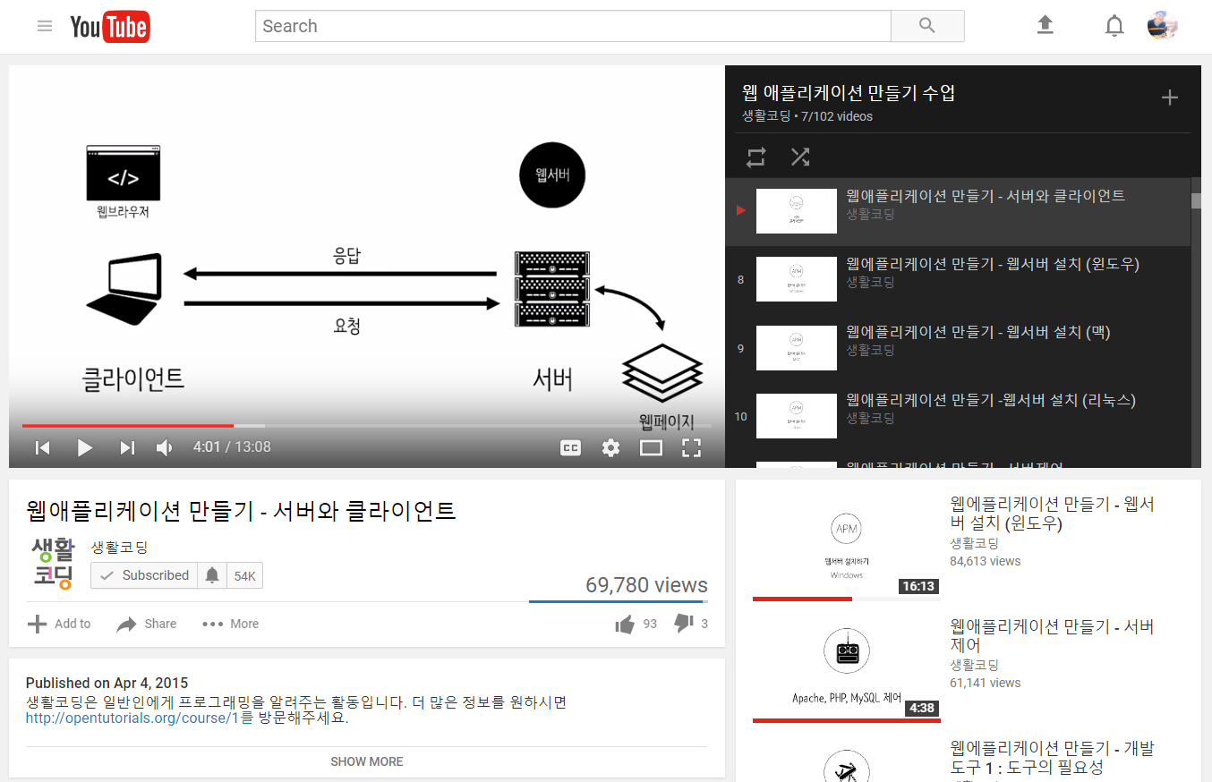
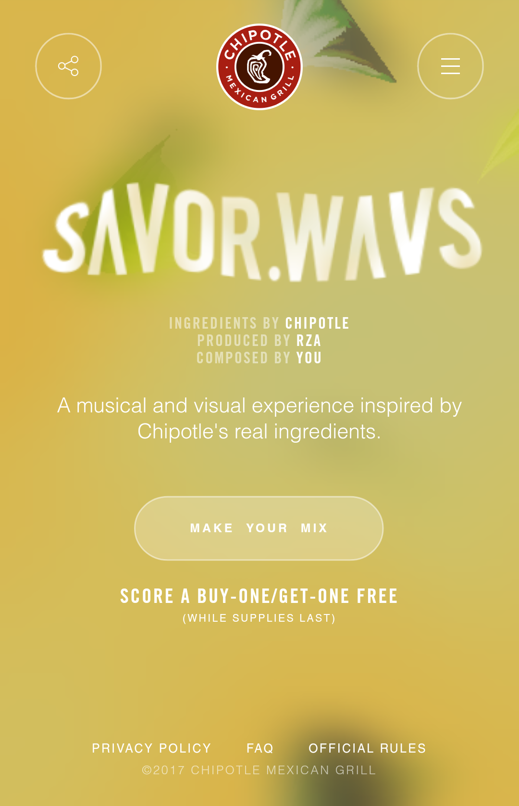
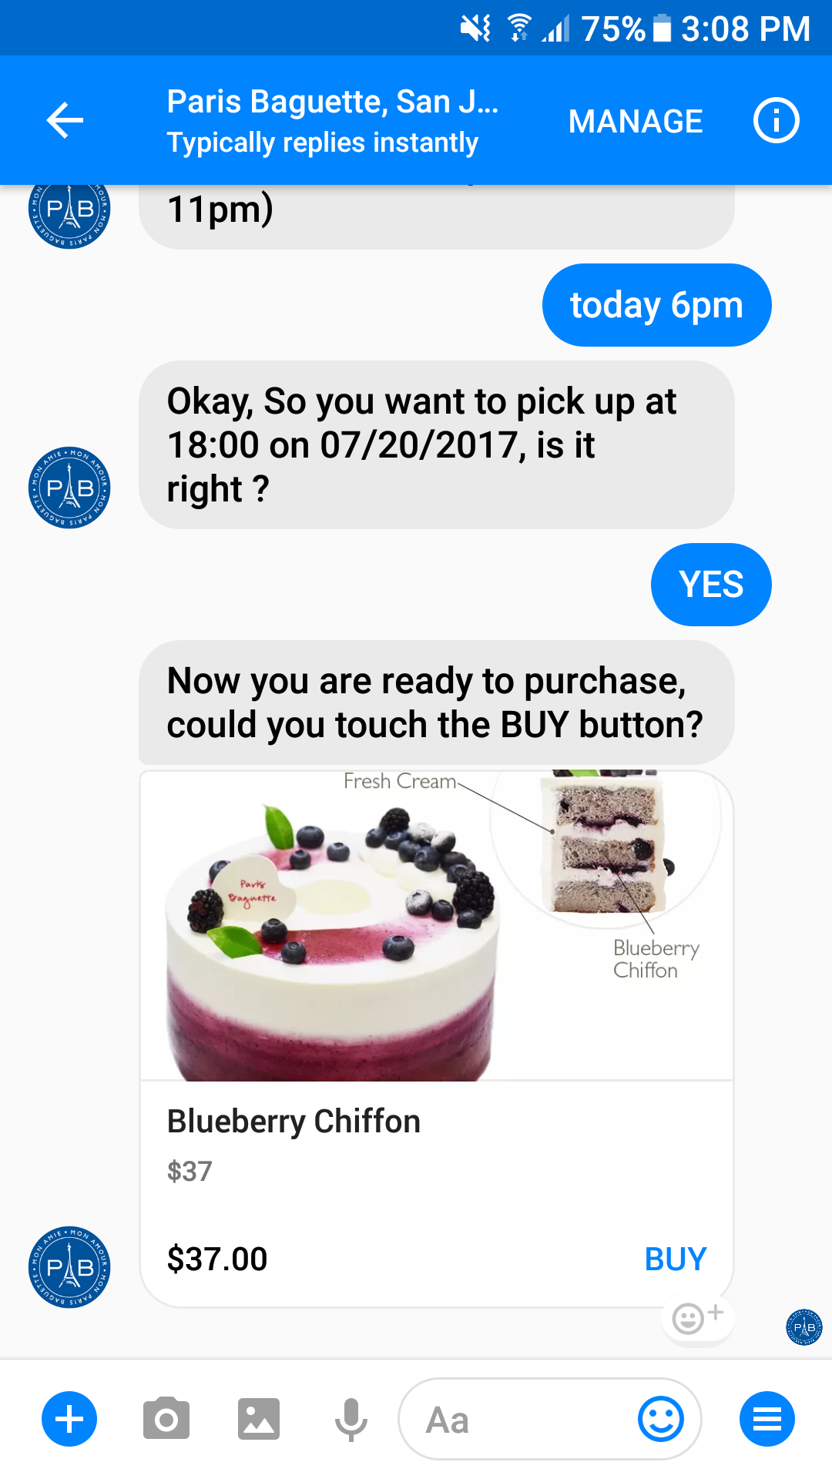
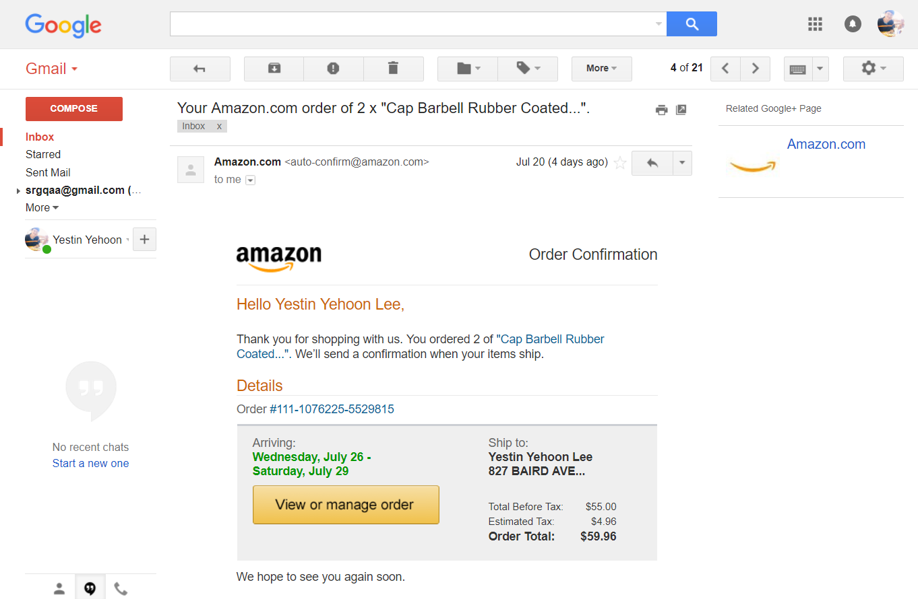
What is Web App?
Program running on the Web
Notes:
What is Web app?
Firstly, when you open the Internet
You can see Google home page, it looks quite simple.
However,
Think about Youtube, it has billions of videos, and it also has ads, playlists, live videos, and so on.
It is totally not a simple web site.
It seems something like programs are running on the web browser.
We call them Web application.

Slide 4
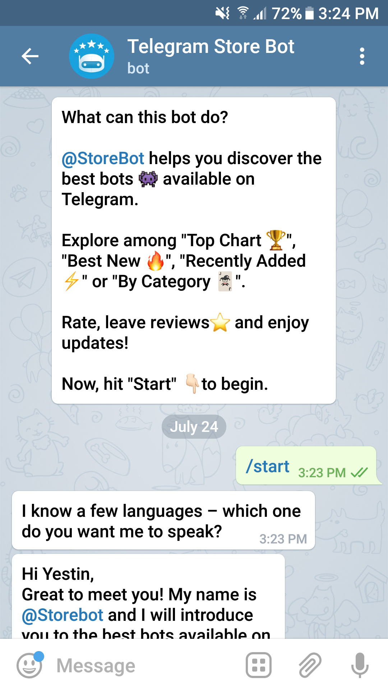
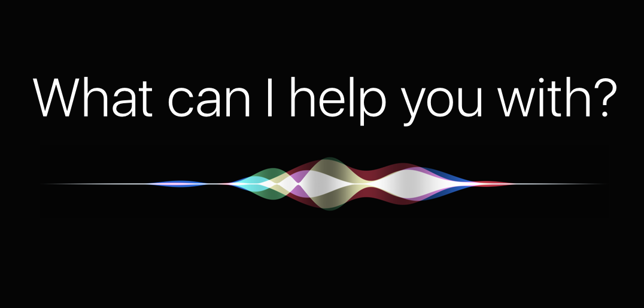
What is ChatBot?
A computer program
Often integrated into the dialog systems
Some of them process natural language
Behave as a conversational partner
Telegram Bot
Notes:
About ChatBot
Used Siri in iPhone.
ChatBot is also a kind of web application.

Slide 5
ChatBot – Pabby Demonstration
m.me/pbsanjose

